Slide 1
Introduction to Design and Analysis of Algorithms

Slide 2

What are problem solving tools?
4. Program
3. Pseudocode
2. Algorithm
Flow chart

Slide 3
Overview and Importance of Algorithms

Slide 4
ALGORITHM
A sequence of unambiguous instructions for solving a problem, i.e. for obtaining the required output for any legitimate input in a finite amount of time

Slide 5
What is an algorithm?
An algorithm is a sequence of unambiguous instructions for solving a problem, i.e., for obtaining a required output for any legitimate input in a finite amount of time.
problem
algorithm
“computer”
input
output

Slide 6
Algorithm
Characteristics of good algorithm
Can be represented various forms
Unambiguity/clearness
Precise
Uniqueness
Effectiveness
Finiteness/termination
Correctness

Slide 7
Notion of algorithm and problem
problem
algorithm
input
(or instance)
“computer”
output
algorithmic solution
(different from a conventional solution)

Slide 8
Compute the GCD for the given two numbers

Slide 9
Euclid’s Algorithm
Problem: Find gcd(m,n), the greatest common divisor of two nonnegative, not both zero integers m and n
Examples: gcd(60,24) = 12, gcd(60,0) = 60, gcd(0,0) = ?
Euclid’s algorithm is based on repeated application of equality
gcd(m,n) = gcd(n, m mod n)
until the second number becomes 0, which makes the problem trivial.
Example: gcd(60,24) = gcd(24,12) = gcd(12,0) = 12
Notes:
Euclid’s algorithm is good for introducing the notion of an algorithm because it
makes a clear separation from a program that implements the algorithm.
It is also one that is familiar to most students.
Al Khowarizmi (many spellings possible...) – “algorism” (originally) and then
later “algorithm” come from his name.

Slide 10
Two descriptions of Euclid’s algorithm
Step 1 If n = 0, return m and stop; otherwise go to Step 2
Step 2 Divide m by n and assign the value of the remainder to r
Step 3 Assign the value of n to m and the value of r to n. Go to Step 1.
while n ≠ 0 do
r ← m mod n
m← n
n ← r
return m

Slide 11
Other methods for computing gcd(m,n)
Consecutive integer checking algorithm
Step 1 Assign the value of min{m,n} to t
Step 2 Divide m by t. If the remainder is 0, go to Step 3; otherwise, go to Step 4
Step 3 Divide n by t. If the remainder is 0, return t and stop; otherwise, go to Step 4
Step 4 Decrease t by 1 and go to Step 2
Is this slower than Euclid’s algorithm? How much slower?
O(n), if n <= m , Vs O(log n)

Slide 12
Other methods for gcd(m,n) [cont.]
Middle-school procedure
Step 1 Find the prime factorization of m
Step 2 Find the prime factorization of n
Step 3 Find all the common prime factors
Step 4 Compute the product of all the common prime factors and return it as gcd(m,n)
Is this an algorithm?
How efficient is it?
Time complexity: O(sqrt(n))

Slide 13
Importance of algorithm
Data structure is an orderly arrangement of data in computers to use it in a more efficient manner.
It’s a collection of data objects that allows storing, organizing, and retrieving data on systems

Slide 14
Relationship between Data Structure and Algorithm
Both are interrelated components
An algorithm appliers to a particular data structure, while the right data structure helps to drastically improve the performance of the algorithm
Major categories of algorithms in relation to DS
Search
Insert
Sort
Update
Delete

Slide 15
In layman’s language, an algorithm can be defined as a step-by-step procedure for accomplishing a task.
In the world of programming, an algorithm is a well-structured computational procedure that takes some values as input and some values as output.
Algorithms give us the most ideal option for accomplishing a task.

Slide 16
The best chosen algorithm makes sure computer will do the given task at best possible manner.
In cases where efficiency matter a proper algorithm is really vital to be used.
An algorithm is important in optimizing a computer program according to the available resources.
Ultimately when anyone decide to solve a problem through better algorithms then searching for the best combination of program speed and least amount of memory consumption is desired.
Here is some importance of algorithms in computer programming.

Slide 17
Importance of Learning DS and Algorithm
Most pivotal topics for programmers and computer science graduates.
Reduces coding cost & Enhances data accuracy
Improve problem solving abilities
Expose to different problem-solving techniques
Competent in DS can resolve tasks related to data processing, automated reasoning or calculations

Slide 18
Various stages of algorithm development for solving a problem
The Four Major Stages of Algorithm Analysis and Design
Design: The first stage is to identify the problem and thoroughly understand it.
Analyze : Once you have the basic framework of the algorithm it's time to start analyzing how efficient the code is in solving the problem.
Implement : Writing and coding the algorithm is the next step in the process. To write the algorithm efficiently you have to know exactly what each line of code is going to accomplish when the program is executed.
Experiment: Once the algorithm is designed and coded go back and experiment with different variables in the algorithm. Try with different data to ensure correctness and efficiency of the algorithm.

Slide 19
An Algorithm Development Process
Step 1: Obtain a description of the problem. This step is much more difficult than it appears.
Step 2: Analyze the problem.
Step 3: Develop a high-level algorithm.
Step 4: Refine the algorithm by adding more detail.
Step 5: Review the algorithm.

Slide 20
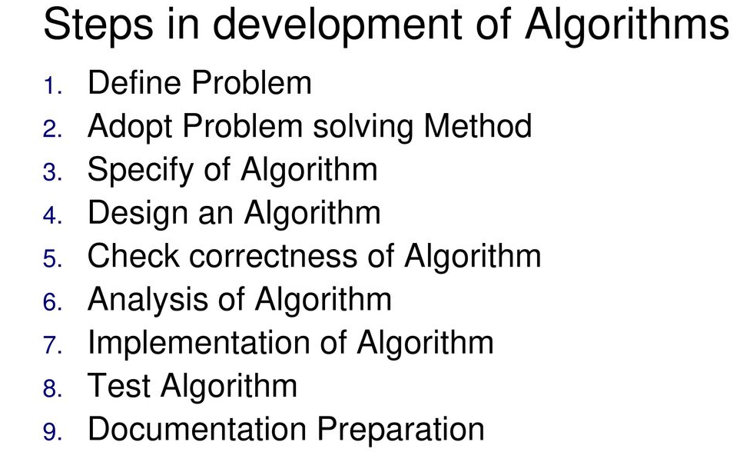

Slide 21
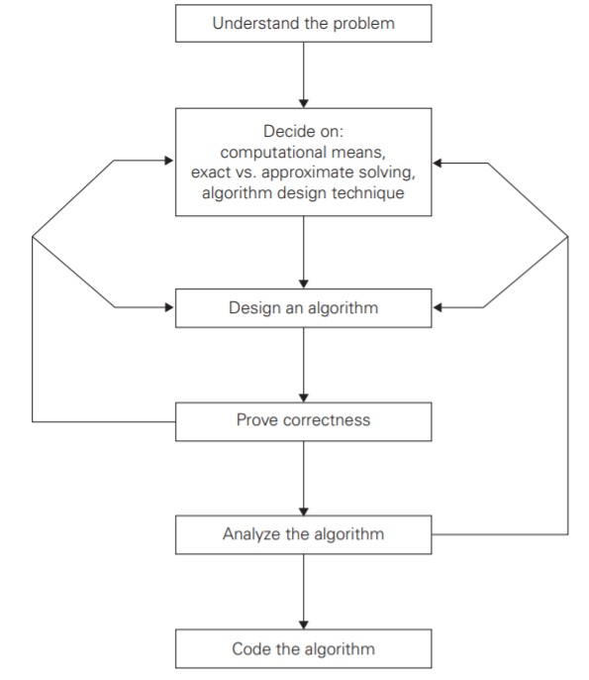
Stages of Algorithm development

Slide 22
Understanding the problem:
Read the problem’s description carefully and ask questions if you have any doubts about the problem. An input to an algorithm specifies an instance of the problem the algorithm solves.

Slide 23

Ascertaining the capabilities of computational device
1. We must know about the machine -its speed and memory
2. We must know whether we develop sequential or parallel algorithms
3. For some algorithms involving huge data, execution time and storage requirement are critical

Slide 24
Choosing between exact and approximate problem solving
We must choose between solving the problem exactly called as exact algorithm or solving it approximately called as approximation algorithm.
Why would one need approximation algorithm?
For example extracting square roots, solving nonlinear equations, and evaluating definite integrals cannot be solved. Second, available algorithms for solving a problem exactly can be unacceptably slow because of the problem’s intrinsic complexity.

Slide 25
Identifying a suitable technique:
An algorithm design technique (or “strategy” or “paradigm”) is a general approach to solving problems algorithmically that is applicable to a variety of problems from different areas of computing.

Slide 26
Identifying a suitable technique
Divide and conquer
Greedy method
Dynamic Programming
Backtracking
Branch and Bound
Brute force
Randomized algorithm
Decrease and Conquer

Slide 27
Divide and Conquer:
The Divide and Conquer strategy involves dividing the problem into sub-problem, recursively solving them, and then recombining them for the final answer.
It is a top-down approach. The algorithms which follow the divide & conquer techniques involve three steps:
Divide the original problem into a set of sub problems.
Solve every sub problem individually, recursively.
Combine the solution of the sub problems (top level) into a solution of the whole original problem.
Example: Merge sort, Quicksort.

Slide 28
Examples
Binary Search
Merge Sort
Quick Sort
Strassen’s Matrix Multiplication
Convex Hull

Slide 29
Greedy Method:
In the greedy method, at each step, a decision is made to choose the local optimum, without thinking about the future consequences.
Greedy method is used to solve the optimization problem.
An optimization problem is one in which we are given a set of input values, which are required either to be maximized or minimized (known as objective), i.e. some constraints or conditions.
Greedy Algorithm always makes the choice (greedy criteria) looks best at the moment, to optimize a given objective.
The greedy algorithm doesn't always guarantee the optimal solution however it generally produces a solution that is very close in value to the optimal.
Example: Fractional Knapsack, Activity Selection.

Slide 30
Example of Greedy Algorithms
Machine scheduling
Fractional Knapsack Problem
Minimum Spanning Tree
Huffman Code
Job Sequencing
Activity Selection Problem

Slide 31
Dynamic Programming:
The approach of Dynamic programming is similar to divide and conquer.
The difference is that whenever we have recursive function calls with the same result, instead of calling them again we try to store the result in a data structure in the form of a table and retrieve the results from the table.
Thus, the overall time complexity is reduced. “Dynamic” means we dynamically decide, whether to call a function or retrieve values from the table.
Dynamic Programming is a bottom-up approach we solve all possible small problems and then combine them to obtain solutions for bigger problems.
Dynamic Programming is frequently related to Optimization Problems.
Example: 0-1 Knapsack, subset-sum problem.

Slide 32
Examples
Multistage Graphs
All Pairs Shortest Path
Single source shortest Path
0/1 knapsack
Travelling Salesman Problem
Flow shop scheduling

Slide 33
Backtracking:
Backtracking Algorithm tries each possibility until they find the right one.
It is a depth-first search of the set of possible solution. During the search, if an alternative doesn't work, then backtrack to the choice point, the place which presented different alternatives, and tries the next alternative.
This technique is very useful in solving combinatorial problems that have a single unique solution.
Where we have to find the correct combination of steps that lead to fulfillment of the task.
Backtracking is not an optimization problem instead it is deciding the solution using multiple options

Slide 34
Such problems have multiple stages and there are multiple options at each stage.
This approach is based on exploring each available option at every stage one-by-one.
While exploring an option if a point is reached that doesn’t seem to lead to the solution, the program control backtracks one step, and starts exploring the next option.
In this way, the program explores all possible course of actions and finds the route that leads to the solution.
Example: N-queen problem, maize problem.

Slide 35
Examples
8 Queen Problem
Sum of Subsets
Graph Coloring
Hamiltonian Cycles
Knapsack Problem

Slide 36
Branch and Bound:
In Branch & Bound algorithm a given sub problem, which cannot be bounded, has to be divided into at least two new restricted sub problems.
Consist of a systematic enumeration of candidate solutions by means of state space search
Branch and Bound algorithm are methods for global optimization in non-convex problems.
Branch and Bound algorithms can be slow, however in the worst case they require effort that grows exponentially with problem size, but in some cases we are lucky, and the method coverage with much less effort.

Slide 37
This technique is very useful in solving combinatorial optimization problem that have multiple solutions and we are interested in find the most optimum solution by considering the minimization approach
In this approach, the entire solution space is represented in the form of a state space tree.
As the program progresses each state combination is explored, and the previous solution is replaced by new one if it is not the optimal than the current solution.
Example: Job sequencing, Travelling salesman problem

Slide 38
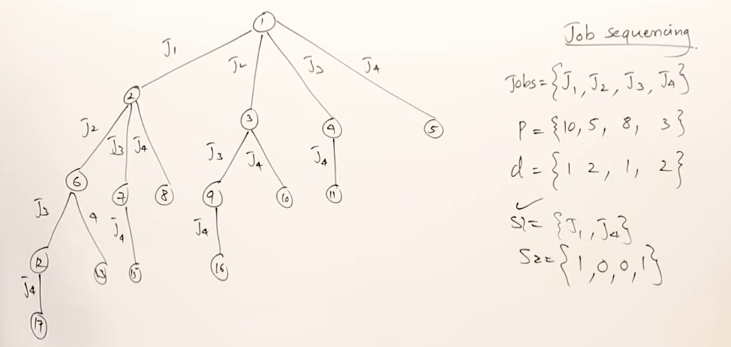
Branch and Bound

Slide 39
Example
0/1 Knapsack problem
FIFO BB
LIFO BB
Travelling Salesman Problem

Slide 40
Randomized Algorithms:
A randomized algorithm is defined as an algorithm that is allowed to access a source of independent, unbiased random bits, and it is then allowed to use these random bits to influence its computation.
A randomized algorithm uses a random number at least once during the computation make a decision.
Example 1: In Quick Sort, using a random number to choose a pivot.
Example 2: Trying to factor a large number by choosing a random number as possible divisors.

Slide 41
Brute force :
A brute force approach is an approach that finds all the possible solutions to find a satisfactory solution to a given problem.
The brute force algorithm tries out all the possibilities till a satisfactory solution is found.
Such an algorithm can be of two types ( Optimizing and satisfying ):
Optimizing: In this case, the best solution is found.
To find the best solution, it may either find all the possible solutions to find the best solution or if the value of the best solution is known, it stops finding when the best solution is found. EX : TSP – Best path is found

Slide 42
Satisficing: It stops finding the solution as soon as the satisfactory solution is found. Or example, finding the travelling salesman path which is within 10% of optimal.
Often Brute force algorithms require exponential time. Various heuristics and optimization can be used:
Heuristic: A rule of thumb that helps you to decide which possibilities
Optimization: A certain possibilities are eliminated without exploring all of them.

Slide 43
Examples
Linked Lists/Doubly Linked Lists
Queues/ Stacks
Hash Maps
Recursion
Sequential search
String matching algorithm
Travelling sales man problem
Knapsack problem

Slide 44
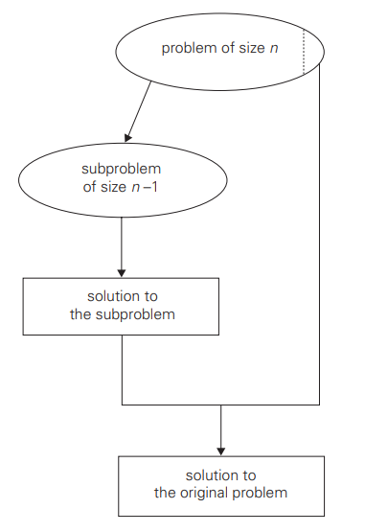
Decrease and conquer
The decrease-and-conquer technique is based on exploiting the relationship between a solution to a given instance of a problem and a solution to its smaller instance. (eg. Non recursive Binary search algorithm)

Slide 45
Design of an algorithm:
Some design techniques can be simply inapplicable to the problem in question.
Sometimes, several techniques need to be combined
Even when a particular design technique is applicable, getting an algorithm often requires a nontrivial ingenuity (imagination) on the part of the algorithm designer.

